Slide 1


welcome

Slide 2

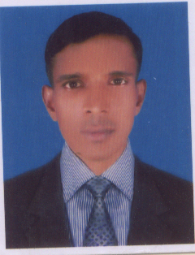
Md. Omar Ali
Assistant Teacher
Moid High School
Brahman Baria (sadar)
Brahman Baria
E-mail-Om0120@yahoo.com

Slide 3
Class- Six
Subject:-English 2nd paper
Lesson: preposition

Slide 4
After Lesson
Students will be able to use the preposition in sentence
Students will be able to find out the preposition from passage

Slide 6


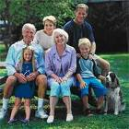
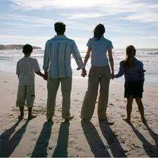
Doctor goes ₋₋₋₋ hospital.
to
The plane flies₋₋₋₋₋₋₋₋₋ the sky.
over
on
at
The men sit₋₋₋₋₋ bench.
They look₋₋₋ the scenery.

Slide 7
To, Over, on, at, in, by, with,
These word are preposition.
Lets go we discuss about preposition.

Slide 8
What's preposition?
Preposition means
Pre
Before
position
place
Preposition is called that which sit before noun or pronoun

Slide 9
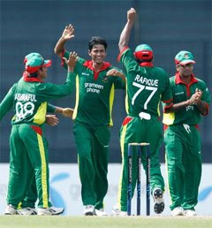
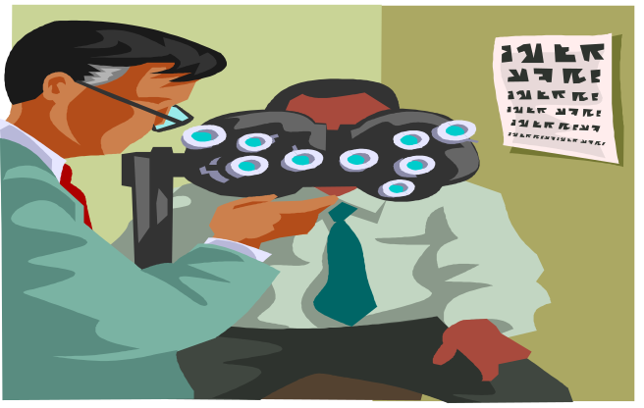




He is looking ----- binocular.
They are enjoying----- their proud.
She is going---- office -------foot.
She is making lesson plan ------- her class.

Slide 10
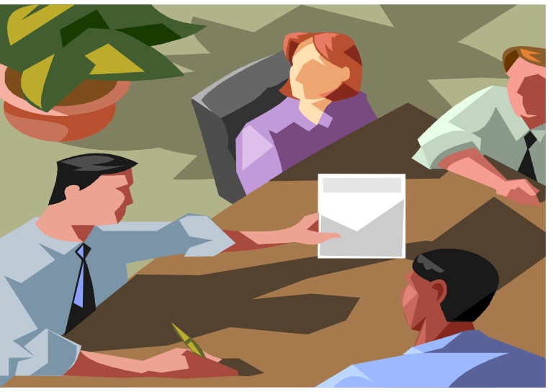
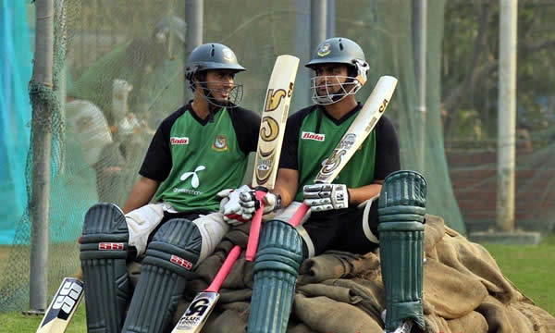
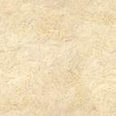
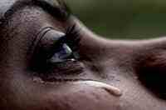
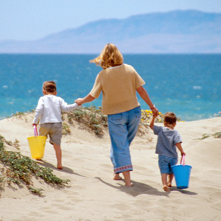
They are discussing---- a matter.
Asrful sat --------Tamim.
The lady crying----- any reason.
The children are walking----- their mother.

Slide 11

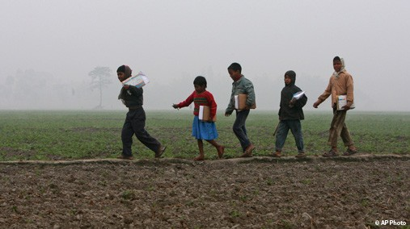

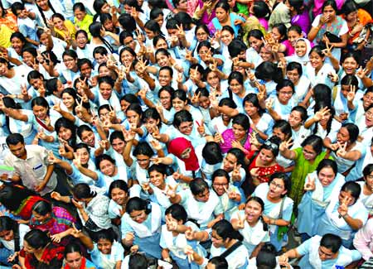
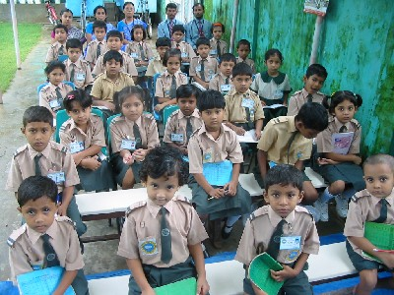

Rain falls ----- the sky.
The students walk ----- field.
They get their result----- internet so they enjoying.
The are looking----the blackboard.

Slide 12

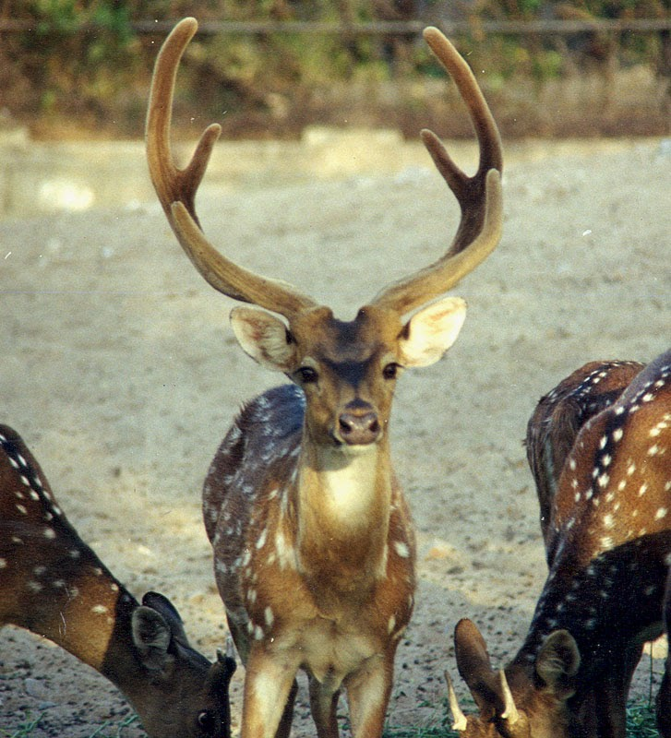
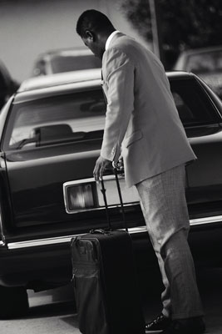

The flower floats ₋₋₋₋₋₋ water.
on
The deer lives---- grass.
The man stood ---- of the car.
They are looking ---------.

Slide 13
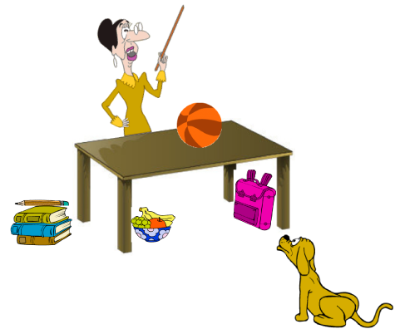
Pair work
Time - 5 minutes
Every pair Writes six sentences to following picture.

Slide 14
Group work
Fill in the gaps with suitable preposition from the box.
to
for
out
with
at
into
from
on
in
under
by
after
upon
over
They are looking -------- the projector.
He goes ------- market everyday --------- foot .
The deer lives ----- grass.
The lily floats ------- water.
The students run ----------- the field.
Rain falls ---- - the sky.
The lady is crying ----------- any reason.

Slide 15
Evalulation
Every body writes three sentences to use preposition.
To write five sentences by preposition.

Slide 16
Home work
Every body Writes five sentences to use preposition

Slide 17

Thanks
Every body
No more today, See you next time.

